Slide 1
IMDB MOVIES ANALYSIS USING MYSQL WORKBENCH

Slide 2
Summary:
In this project, we will conduct a compressive analysis of IMDB Movies data. Our objective is to derive valuable insights and make informed decisions based on the available data. This project helps to keep track of movies, their directors, actors, genres and ratings, making it valuable tool for movie related data management and analysis.
Problem Statement:
The production company wants to plan its every move analytically based on data and has approached you for help with this new project. You have been provided with the data on the movies that have been released in the past three years. You have to analyse the data set and draw meaningful insights that can help them start their new project.

Slide 3
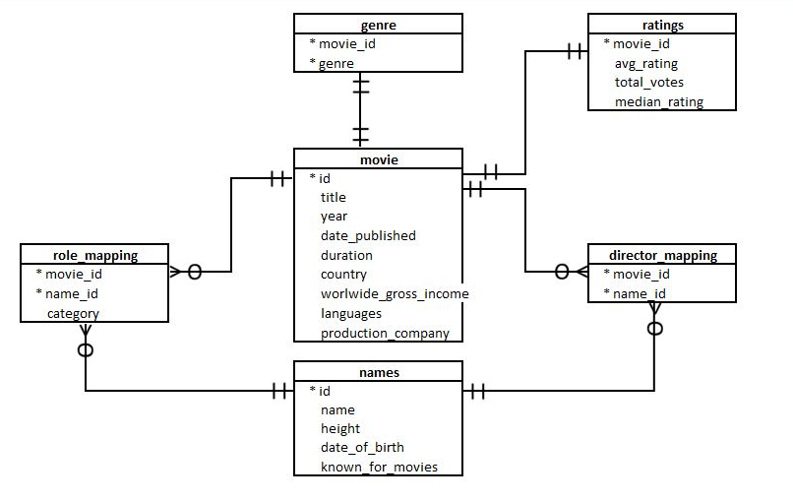
ERD (Entity Relationship Diagram):

Slide 4
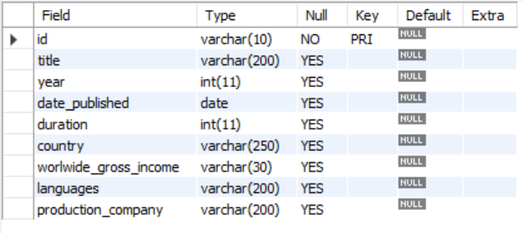
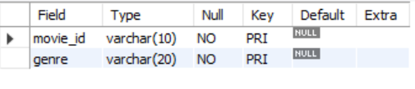
STRUCTURE OF TABLES :
Movie: -
Genre: -

Slide 5
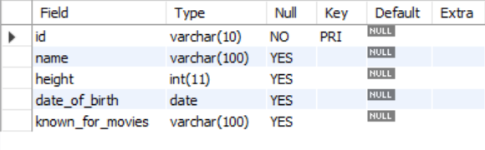
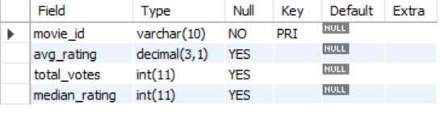
Names: -
Ratings: -

Slide 6
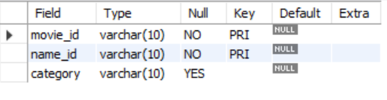
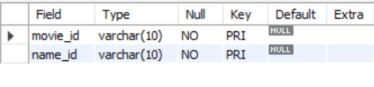
Roll Mapping: -
Director Mapping: -

Slide 7
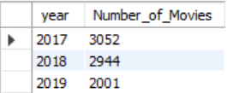
1. Display the total number of movies released each year?
Query:
SELECT year, COUNT (id) as Number_of_Movies FROM movie GROUP BY year;
Output:

Slide 8
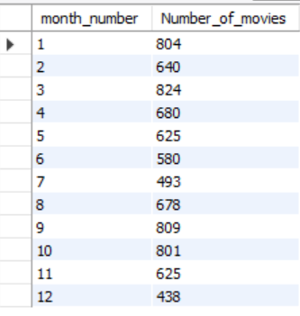
2. Display Total number of movies month wise
Query:
SELECT month(date_published) as month_number,COUNT(id) as Number_of_movies
FROM movie GROUP BY month_number ORDER BY month_number;
Output:

Slide 9
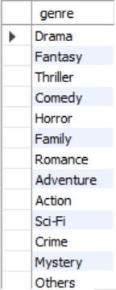
3. Display unique list of the genres present in the data set.
Query:
SELECT DISTINCT (genre) FROM genre;
Output:

Slide 10
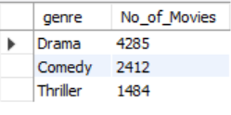
4. Display the genre with highest number of movies produced overall.
Query:
SELECT genre,COUNT(movie_id) as No_of_Movies
FROM genre
GROUP BY genre
ORDER BY No_of_Movies DESC LIMIT 1;
Output:

Slide 11
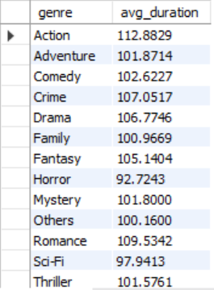
5. Display the average duration of movies in each genre.
Query:
SELECT g.genre, AVG(m.duration) as avg_duration FROM genre g
INNER JOIN movie m ON g.movie_id = m.id
GROUP BY g.genre;
Output:

Slide 12
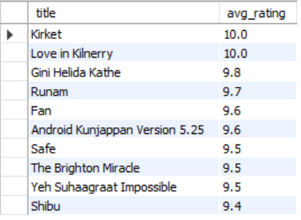
6. Display top 10 movies based on average rating.
Query:
SELECT m.title,r.avg_rating
FROM movie m
INNER JOIN ratings r
ON r.movie_id = m.id
ORDER BY r.avg_rating DESC LIMIT 10;
Output:

Slide 13
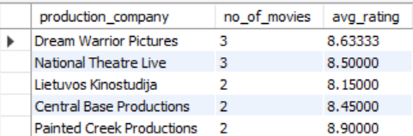
7. Display production house with the most number of hit movies (average rating > 8)??
Query:
SELECT m.production_company, COUNT(m.id) as no_of_movies,
AVG(r.avg_rating) as avg_rating
FROM movie m
INNER JOIN ratings r
ON r.movie_id = m.id
WHERE m.production_company IS NOT NULL
AND r.avg_rating > 8
GROUP BY m.production_company
ORDER BY no_of_movies DESC;
Output:

Slide 14
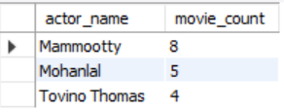
8. Who are the top two actors whose movies have a median rating >= 8?
Query:
SELECT n.name as actor_name, count(rm.movie_id) as movie_count
FROM names as n
INNER JOIN role_mapping as rm ON rm.name_id = n.id
INNER JOIN ratings as r ON r.movie_id = rm.movie_id
WHERE r.median_rating >= 8 AND rm.category = 'actor'
GROUP BY actor_name ORDER BY movie_count DESC LIMIT 3;
Output:

Slide 15
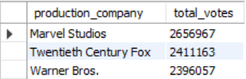
9. Display top 3 production houses based on number of votes received by their movies.
Query:
SELECT m.production_company,SUM(r.total_votes) as 'total_votes'
FROM ratings r
INNER JOIN movie m ON m.id = r.movie_id
GROUP BY m.production_company
ORDER BY total_votes DESC LIMIT 3;
Output:

Slide 16
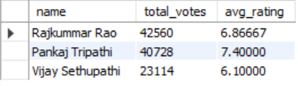
10. Display top 3 actors based on votes nad avg rating in India.
Query:
SELECT n.name,SUM(r.total_votes) as 'total_votes',AVG(r.avg_rating) as 'avg_rating'
FROM names n
INNER JOIN role_mapping rm ON n.id = rm.name_id
INNER JOIN movie m ON rm.movie_id = m.id
INNER JOIN ratings r ON m.id = r.movie_id
WHERE rm.category = 'actor' AND m.country = 'India'
GROUP BY n.name HAVING COUNT(DISTINCT m.id) >= 5
ORDER BY total_votes DESC, 'avg_rating' DESC LIMIT 3;
Output:

Slide 17
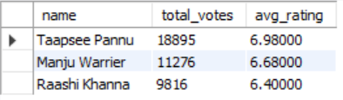
11. Display top 3 actors based on votes and avg rating in India
Query:
SELECT n.name,SUM(r.total_votes) as 'total_votes',AVG(r.avg_rating) as 'avg_rating'
FROM names n
INNER JOIN role_mapping rm ON n.id = rm.name_id
INNER JOIN movie m ON rm.movie_id = m.id
INNER JOIN ratings r ON m.id = r.movie_id
WHERE rm.category = 'actress' AND m.country = 'India'
GROUP BY n.name HAVING COUNT (DISTINCT m.id) >= 5
ORDER BY total_votes DESC, 'avg_rating' DESC LIMIT 3;
Output:

Slide 18
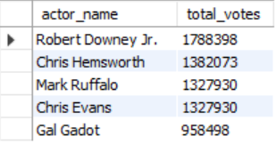
12. Display top 5 actor/actress have the highest total votes received.
Query:
SELECT n.name AS actor_name, SUM(r.total_votes) AS total_votes
FROM names n
JOIN role_mapping rm ON n.id = rm.name_id
JOIN movie m ON rm.movie_id = m.id
JOIN ratings r ON m.id = r.movie_id
WHERE rm.category IN ('actor', 'actress')
GROUP BY actor_name
ORDER BY total_votes DESC LIMIT 5;
Output:

Slide 19
CONCLUSION
The following insights were derived after analysing the IMDb dataset:
1. Maximum number of movies was released in the year 2017. Also, the highest number of movies is produced in March is 824 movies
2. There are 13 unique genres in the dataset, from which Drama has highest number of movies produced i.e., 4285 and an average duration of 106.77 minutes
3. Also, the average length of Action movies is the highest and Horror movies have the shortest average length.
4. Kirket and Love in Kilnerry are the two top rated movies. They have an average rating of 10/10.
5. Dream Warrior Pictures and National Theatre Live both has produced highest rated films
6. Marvel Studios, Twentieth Century Fox and Warner Bros. are the three production companies that have received the maximum number of votes.
7. In India, Taapsee Pannu can be chosen as the top actress with average rating 7.74 and top actor is Vijay Sethupathi with average rating 8.42.

